Slide 1
Smart Watch
Eyal Loschitzky & Eilia Swed
28.10.25

Slide 2
Background and Objectives
Background
Falls and health-related incidents can occur unexpectedly in everyday settings. Affordable, embedded systems that continuously sense movement and basic physiological and environmental signals—while providing clear on-device feedback and a simple SOS channel—can improve safety and responsiveness. This project implements such a system on a low-cost microcontroller, combining motion analysis (for fall detection), basic vital/ambient monitoring, and a minimal user interface.
Objectives
Main Objective: Design and implement a real-time, multi-sensor monitoring system on the NUC140 that detects falls, displays live readings, and can transmit alerts over Bluetooth.
Sub-objectives:
Acquire analog signals from heart-rate sensor (ADC CH6), temperature sensor (ADC CH7), and joystick axes (ADC CH5/CH4).
Read 3-axis acceleration from MPU6050 over I²C and perform a two-stage fall-detection algorithm (low-G → high-G).
Provide a simple UI on LCD1602 (I²C) with multiple screens: Home/Clock, Temperature, Heart BPM, Emergency, and Fall Alert.
Implement Bluetooth (HC-05 over UART0 GPB0/GPB1) to send SOS/alert messages.
Use a timer interrupt (1 ms tick) for timekeeping and stable loop timing; implement basic peak detection to convert raw heart signal to BPM.
Enable user navigation and time setting using the joystick (axes + button on GPB9).

Slide 3
System Description

Slide 4
Flow Chart

Slide 5
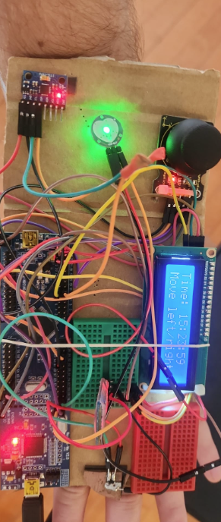
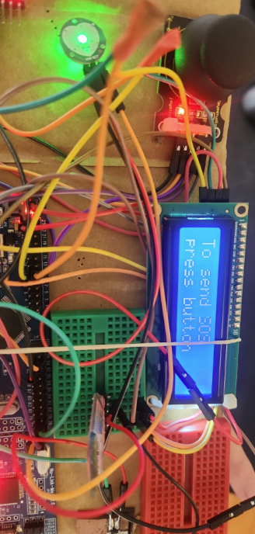
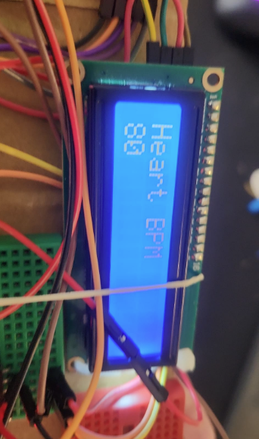
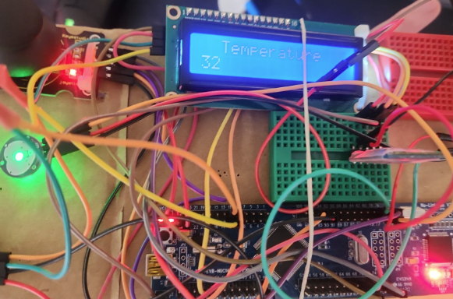
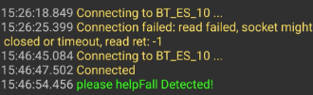
Results and Testing

Slide 6
Conclusion and Future Work
Achievements
Through the developed firmware, the system was able to:
Continuously measure temperature, heart rate (BPM), and motion acceleration.
Detect potential falls using a two-stage (low-G / high-G) detection algorithm.
Display all readings and menus on the LCD1602 screen, with joystick-based navigation.
Transmit alert messages, including emergency or fall events, via Bluetooth communication to a remote computer.
Challenges
Calibrating the MPU6050 sensor and tuning the fall-detection thresholds to minimize false triggers.
Handling signal noise from the heart-rate sensor to achieve more stable BPM readings.
Synchronizing multiple peripherals (I²C, UART, ADC, and timers) under real-time constraints.
Improvements / Next steps
Adding wireless data logging or a mobile app for remote monitoring.
Implementing machine learning for smarter fall classification and adaptive thresholding.
Integrating additional sensors such as humidity or SpO₂ for broader health monitoring.
Optimizing the power consumption and miniaturizing the hardware for wearable use.

